Slide 1
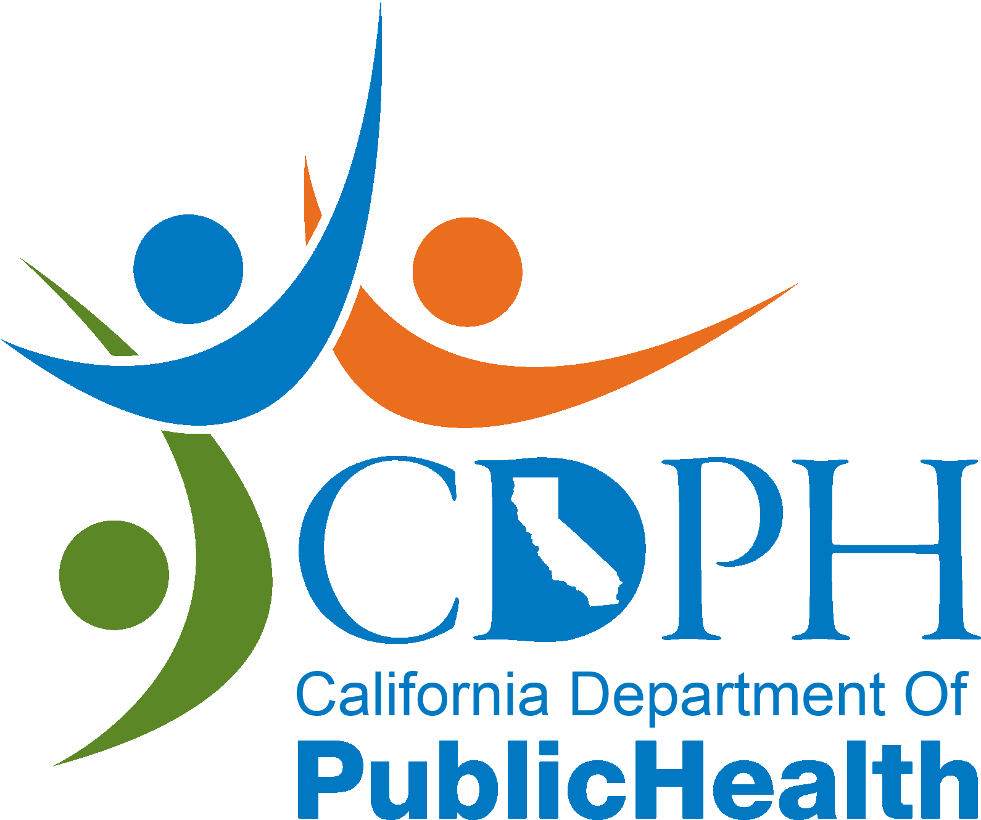
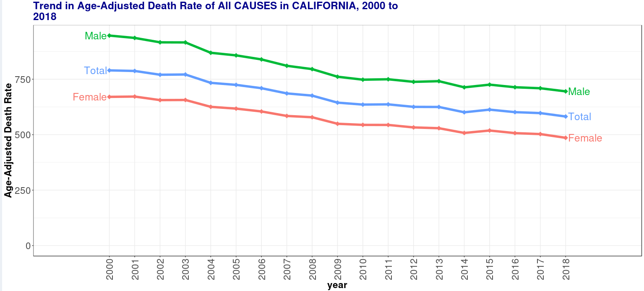
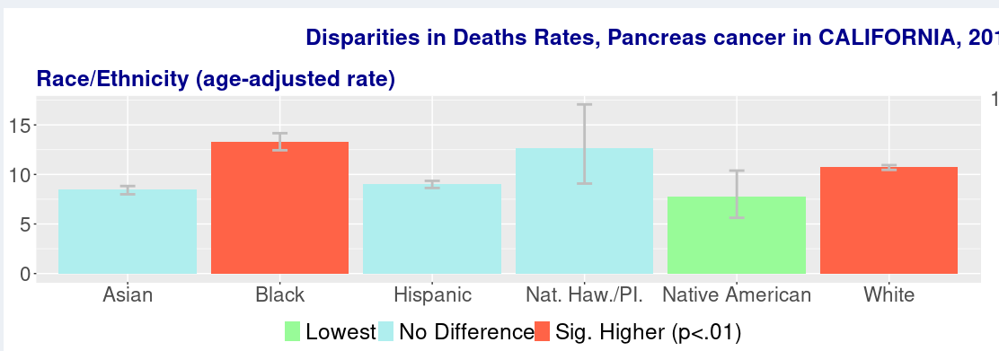
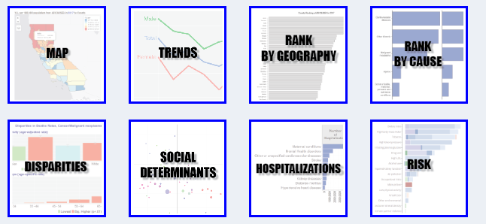
PUBLIC
HEALTH
WORKS
Decreases in overall mortality (and concomitant increases in life expectancy), and, have been experienced by all groups in California, including males and females, all race/ethnic groups, and in all geographic areas. These increases are do to improved medical care, and more importantly, a result of public efforts in general areas like clean water and air, healthy diets, and exercise in safe places, and specific areas like increased seat-beat use and decreased smoking. Public Health Works!
While great progress has been made, some causes of disease and death are increasing in California, like Alzheimer’s disease, kidney disease, and deaths from opioids. Furthermore, even with overall progress, for many conditions, there are large and unacceptable disparities between groups, especially between racial/ethnic groups. Eliminating these disparities requires sustained work using core public health tools, and, importantly requires broad collaborative efforts to address the Social Determinants of Health, like education, income/wealth, and racism.
AND MUCH MORE NEEDS TO BE DONE
The California Community Burden of Disease and Cost Engine, is a tool to provide information needed to sustain and improve Public Health efforts. The tools provides data on detailed causes of deaths and hospitalizations, for California counties and communities, over many years. The tool provides maps, trends and ranking charts to answer many questions, and to generate and explore hypotheses
More information on how to use the tool

